Slide 1


LIBERTY ELECTRONICS.
We serve the best
GROUP
FALCULTY DATA
MUHAMMAD SHAHEER Std1401788
SOHAIB IRSHAD Std1407075
LAIBA ZAFAR Std1397240
4. MALIK ALI Std1399179
FALCULTY NAME : SIR AMIR HAMZA.
COORDINATOR NAME : ARIBA KHAN.
CENTER NAME : NORTH NAZIMABAD.
GROUP : (B).
BATCH : 2207G3.

Slide 2

INTRODUCTION OF OUR PROJECT
(PAGE)
Our EProject consists of A Electronic shop It has a Beautiful Home page About us page and Brands with a dropdown menu and contact us and login and signup
it has a beautiful navbar then A beautiful carousel. this carousel has three beautiful pictures.
After the navbar and Carousel we have a beautiful services section in this services section has Three beautiful icons and these icons have a beautiful CSS Hover effect if you click these icons.
Now After the navbar, carousel, And Services Section we have one Banner with some Text.
After the banner we have a beautiful product section this product section consists of six product
On this home page we have some blog post’s about our website and other information. If the user clicks any blog post on the home page then he/she will go official blog page.
And after the banner and text we have a beautiful subscription Panel if you want to update all the latest new products so you also need to subscribe to our website
And after all of this we have a beautiful footer with some menu options and some icons and <i> frame of Google map
All links on our home page are active and our home page is fully responsive and beautiful ….!

Slide 3

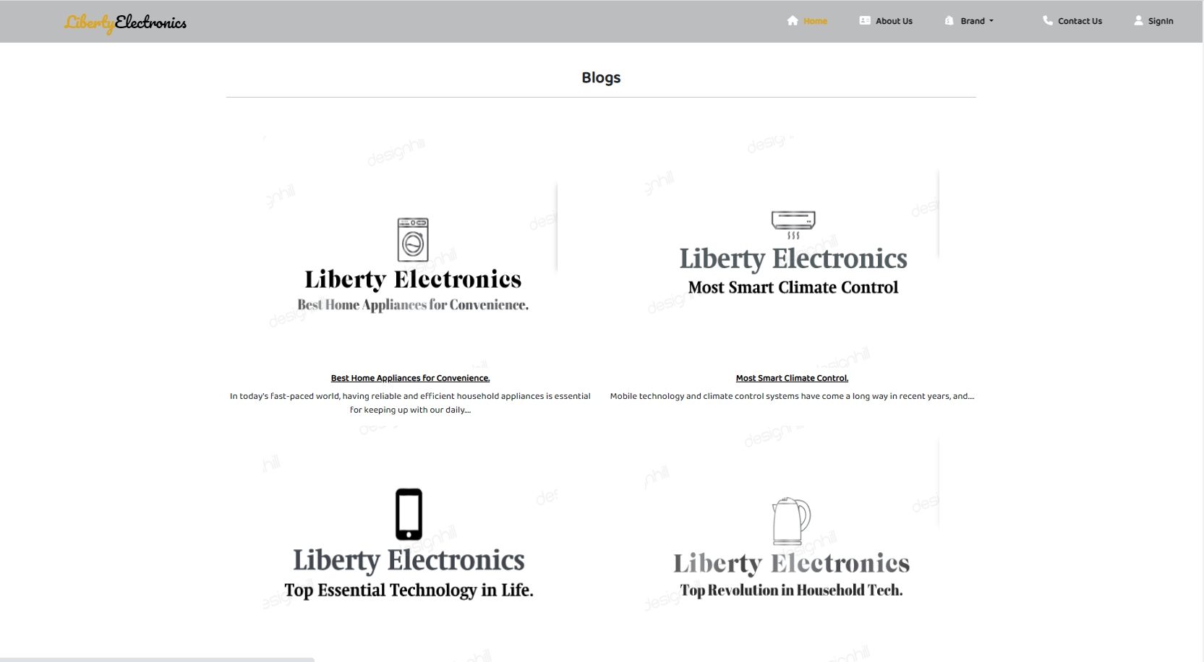
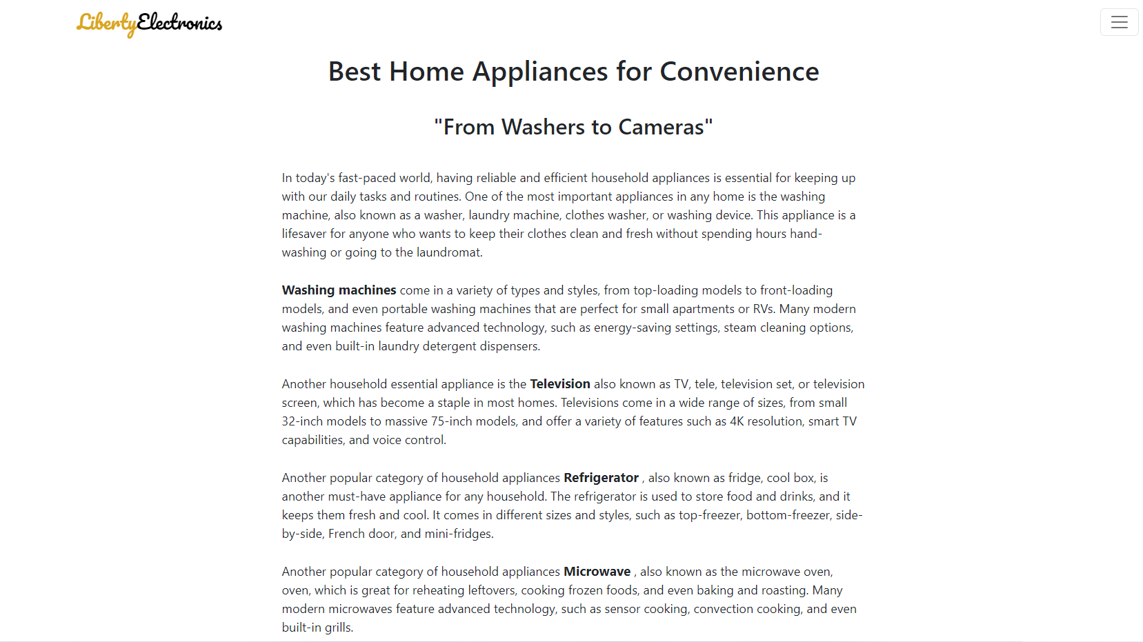
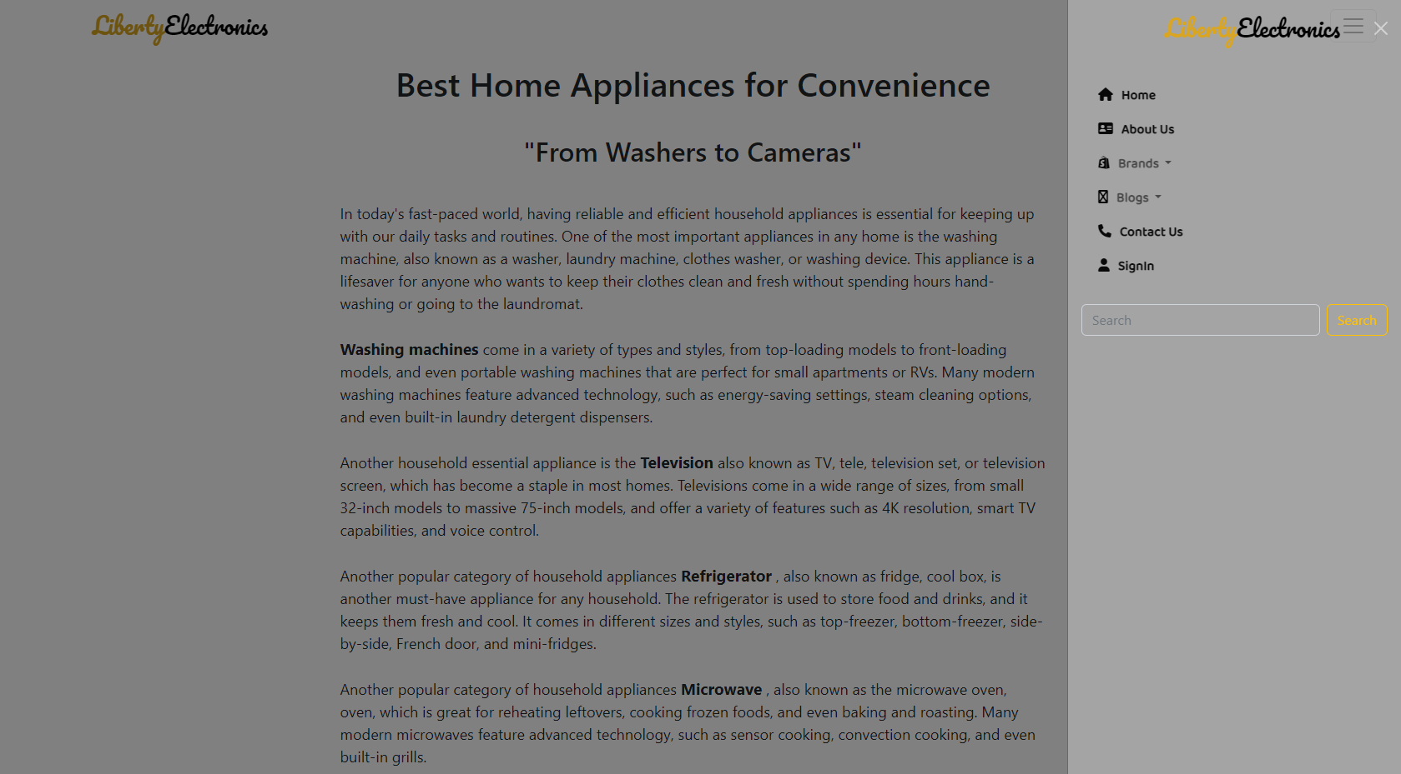
BLOG SECTION AND ITS PAGES.
Blogs
Our blog page consists of our Eproject topic all are informed of our website inside this.
We make a blog section on the home page and official blog page on our website if the user clicks any blog on the home page then he/she will redirect to the official blog page.
We replaced the navbar with Off-canvas on Blog pages.
We make blog pages that use particular Keywords like Mobile phone, cheap Mobile phone, washing machine, Refrigerators, Microwave Oven, and Many more Like this. Because it is used as SEO keywords that help to rank our website on Google Search engine.

Slide 4
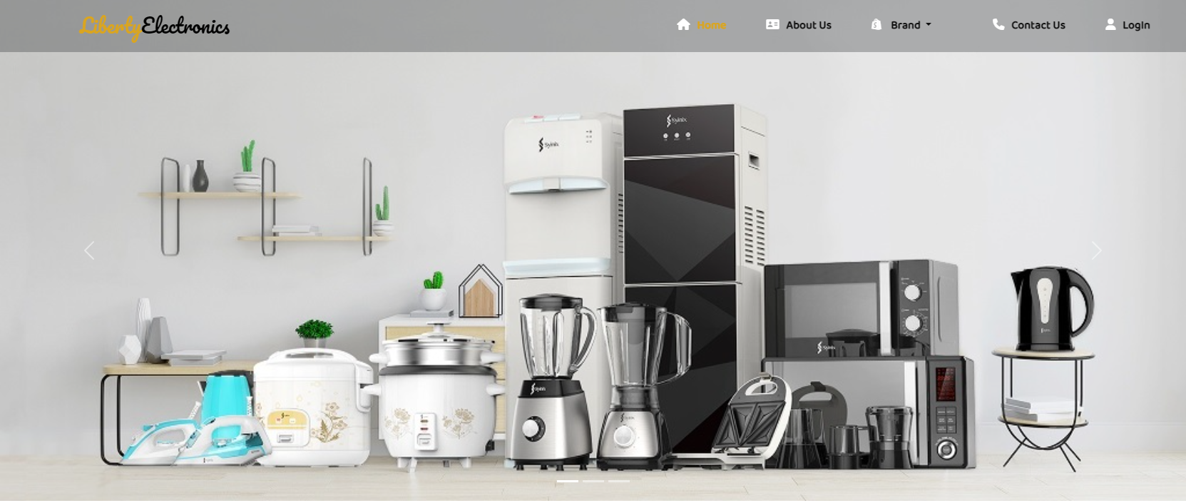
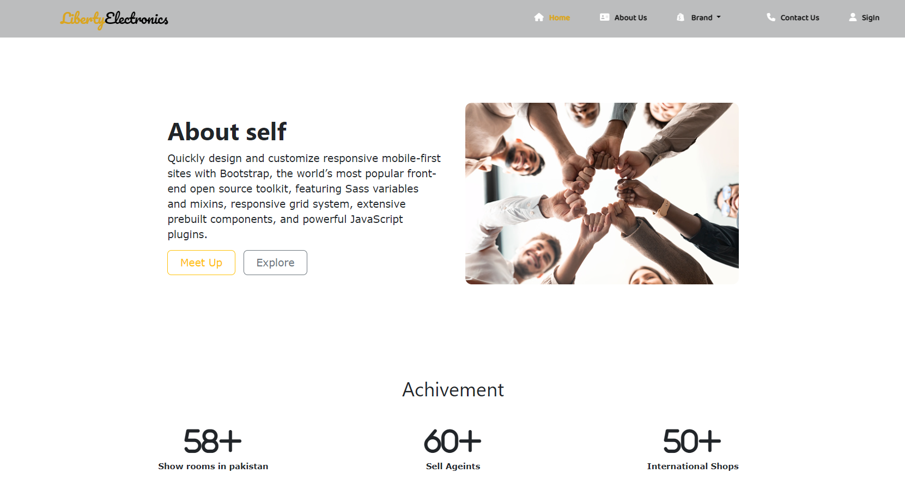
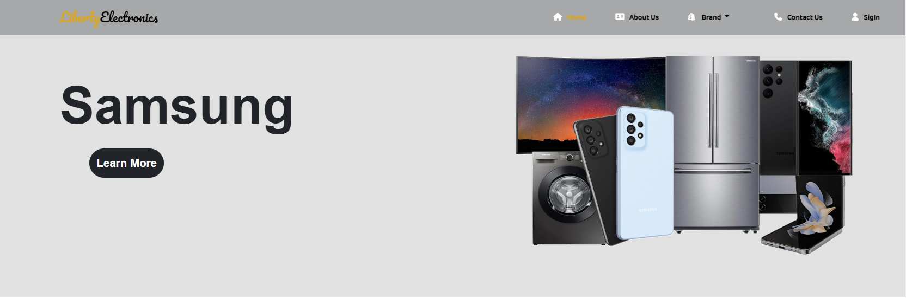
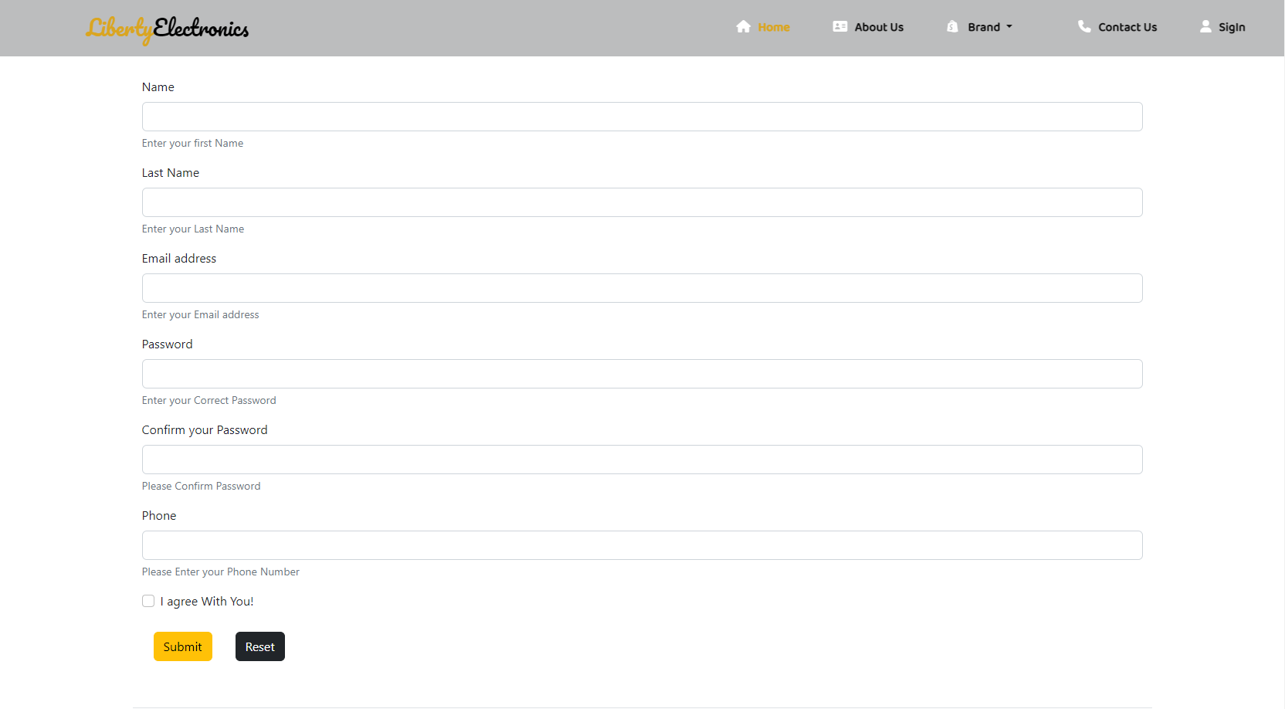
SNAP SHOTS
HOME PAGE
ABOUT US PAGE
BRANDS PAGE
CONTACT US PAGE

Slide 5
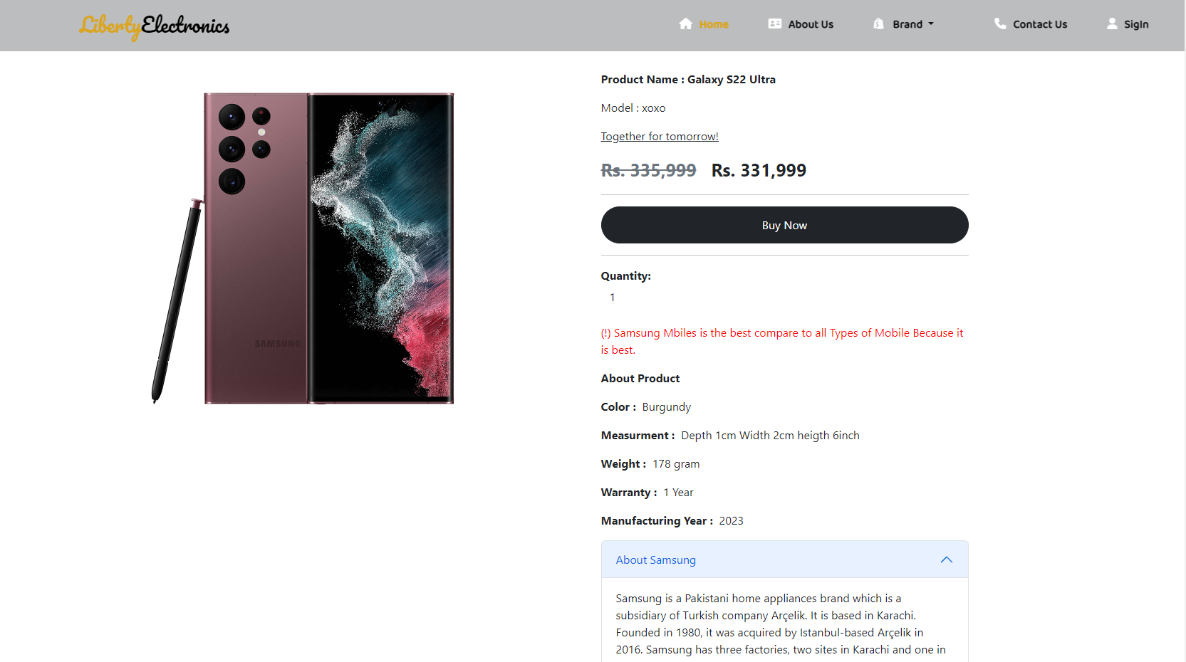
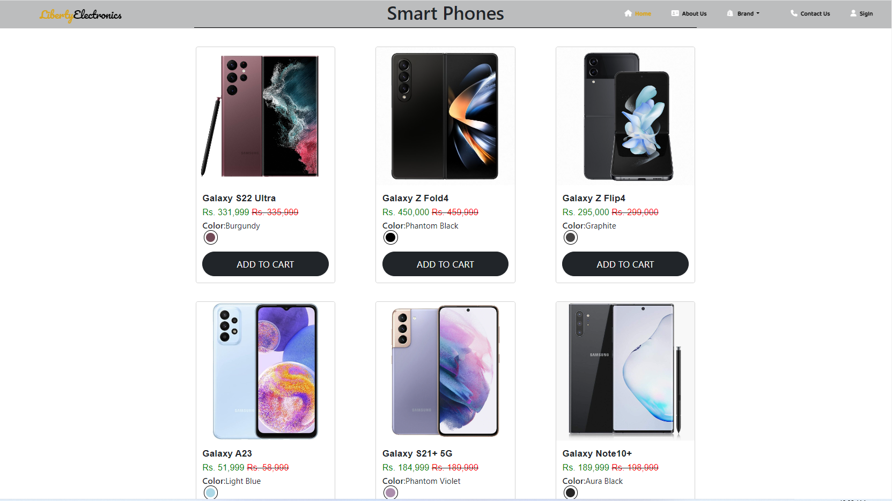
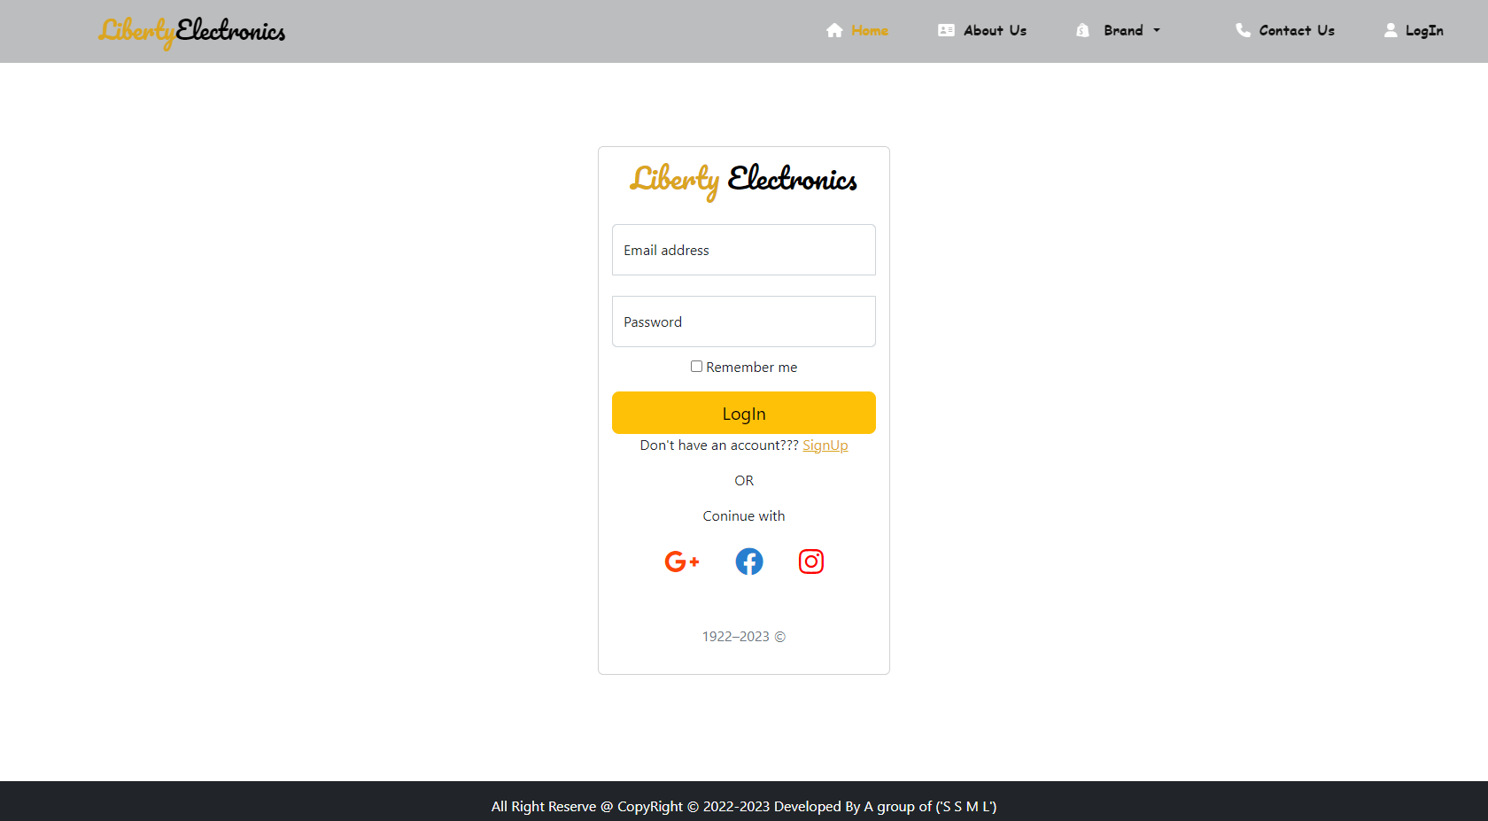
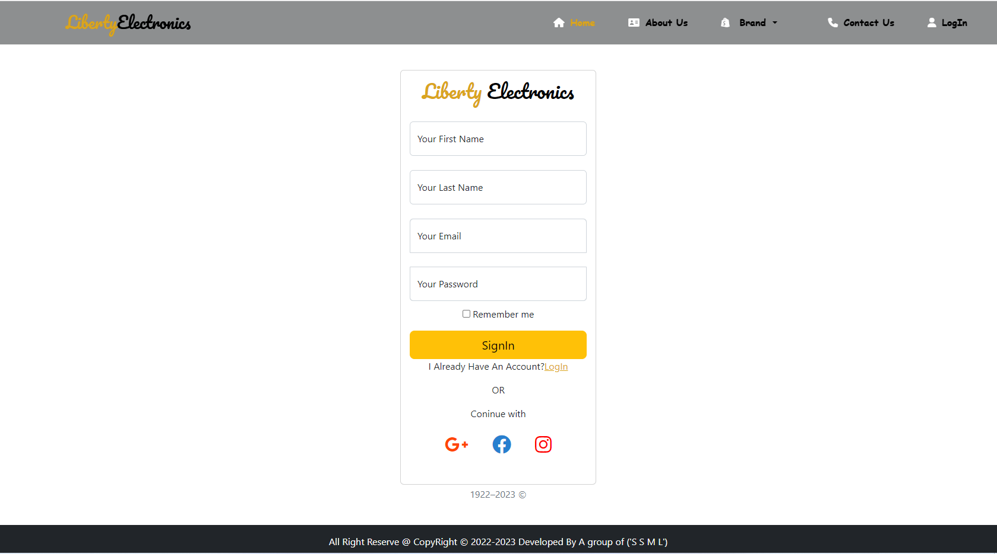
SNAP SHOTS
ONE PRODUCT PAGE
SMART PHONE BRANDS SECTION
LOGIN PAGE
SINGIN PAGE

Slide 6

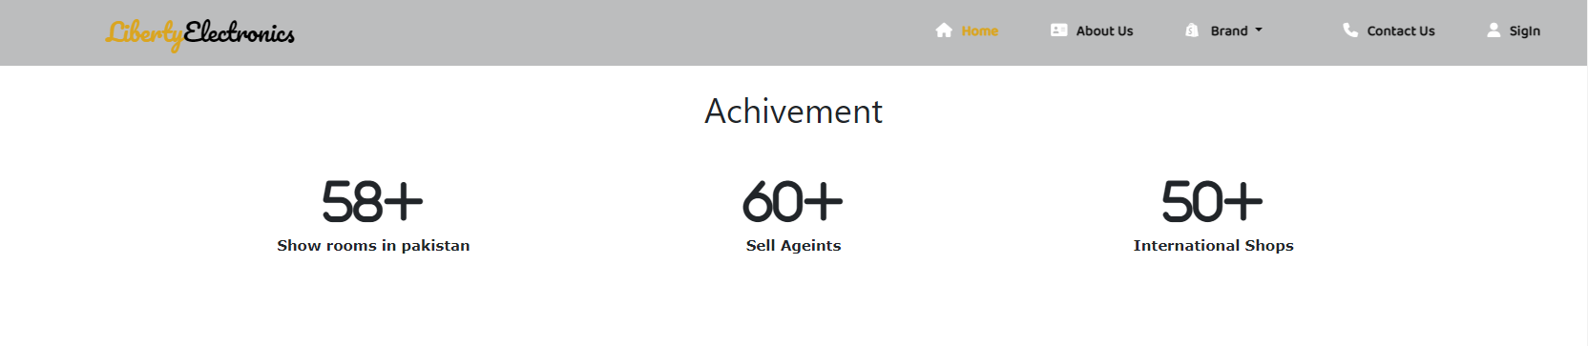
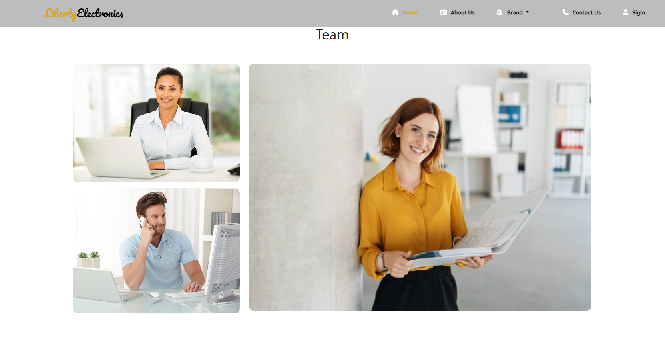
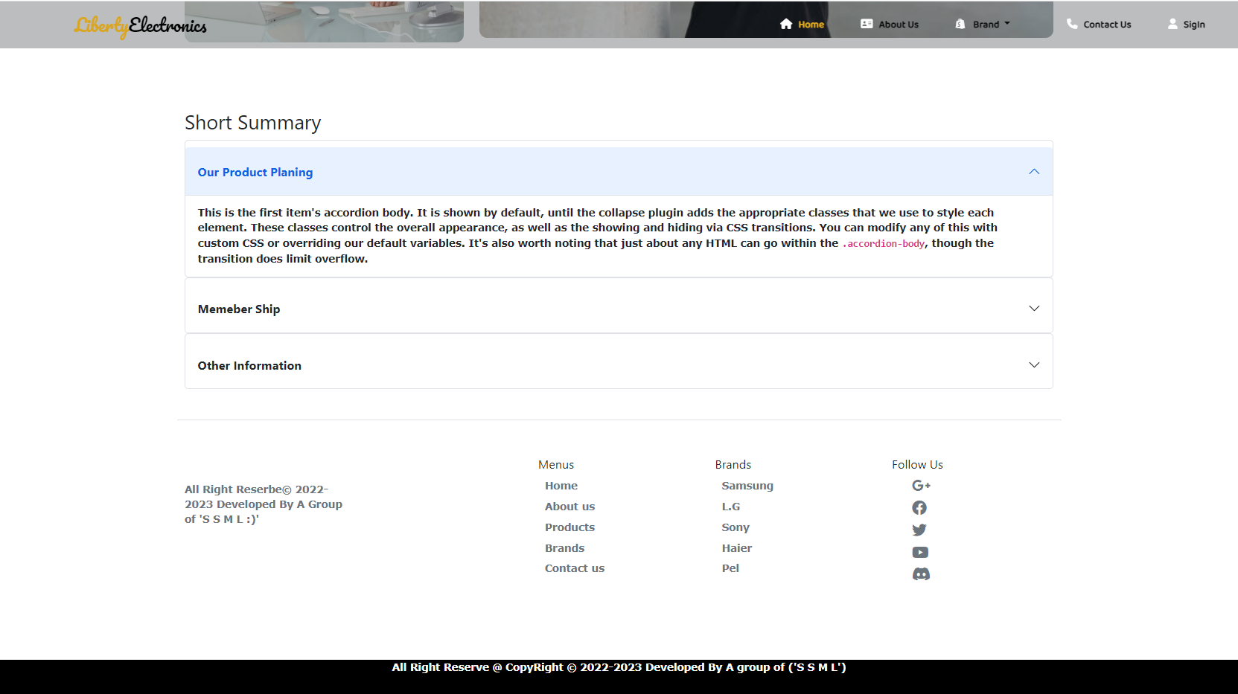
ABOUT US PAGE OF OUR PROJECT
About us page
About us page consists of a fixed and responsive navbar with and.
After the navbar we have one grid row in this grid we have some text for ourselves second we have one picture with a beautiful CSS hover effect if you want to see the hover effect so click on this picture.
After this grid we have another grid row in this grid row we have the same 4x md columns in this column we have some icons these icons represent our achievements and Goals and more then.
And then after this section we have another section for our team Members this section consists of pictures of our team members.
Then we have Three accordions this accordion describes the story and history of our shop and products and many more…
After all section’s we have the same footer here as well.

Slide 7

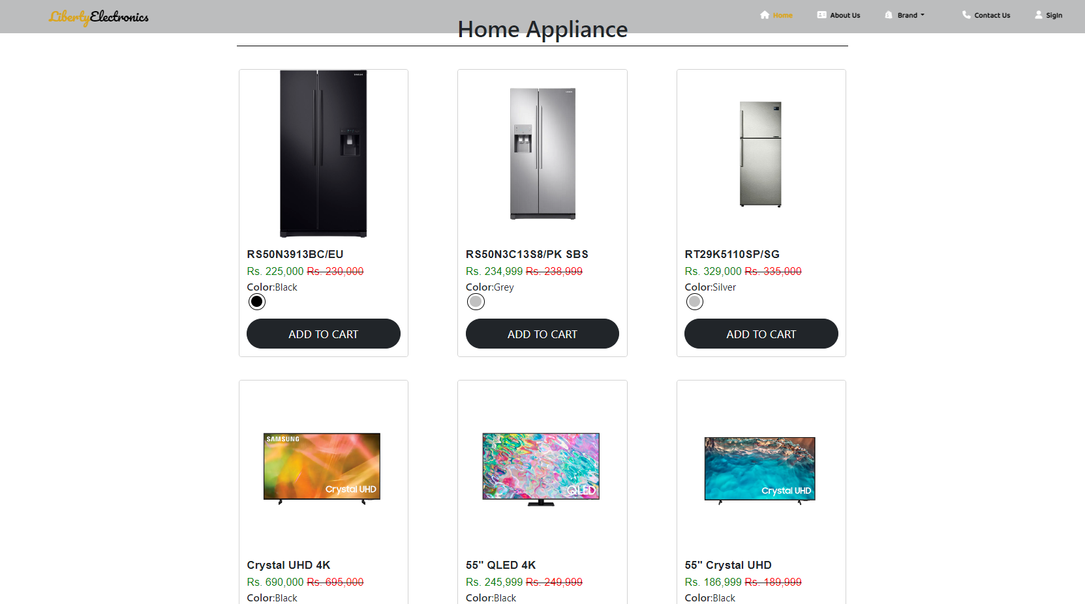
BRANDS PAGE OF OUR PROJECT
Brands and shop page
Our Brands Section consists of A Lot of electronics brands Like Dawlance, Orient, Pel, Sony, And many more.
If our user clicks any Brand, he/she was redirected to our brand and shop page, consisting of one product banner with the brand name and its picture.
If the user scrolls down the page then we have a lot of products of particular brands on this page like Mobile phone refrigerator hand watches washing Machin and many more items on the product page.
If our user clicks any particular product item then he/she will redirect to our product page.
Our one product page consists of the same navbar of the webpage and product picture with a beautiful hover effect if you hover the picture.
On this page we have full information like product name, model, prize quantity, and product description, and one accordion in this accordion we have provided other information about our production company and our website.
Then we have a responsive footer.

Slide 8

CONTACT US PAGE OF OUR PROJECT
CONTACT US PAGE
This is our contact us page we have some input fields like the user’s first name last name phone number Email & message.
Contact us form has to button Submit button and reset button if you click submit button so your data will be submitted to our server. If the user clicks the reset button so your form will be reset.
if the User wants to communicate so he needs to fill out our contact us form.
And then we have the same footer with the email address & shop address with it.

Slide 9
PROBLEM STATMENTS
Liberty Electronics is a shop selling various electronic products. The company advertises by distributing the pamphlets, advertising on television and so on. Due to rapid development in internet field, the company decides to launch a website where people will get all the information about the various products available with them easily.
Requirement Specification:
The Web site is to be created based on the following requirements.
The Home Page should be created making use of sections with a suitable logo
The site should display a menu which will contain the options for brief introduction about the various products available, location of the shop and any other information if required.
The information should be categorized according to the brand names of the products like if a User wants to see only Samsung products then he click on a Link/button/menu etc. and he will see only That Brand products.
When a user selects any particular brand, a list of products for that brand will be displayed
A brief summary of features of individual products should be displayed on the Web Page along with the product but detailed Features should be stored in Individual Word documents which can be downloaded or viewed by the User who wishes to see the same.
The user should also be able to compare the various products of different as well as similar brands.
There should be a “Contact Us” page which will have the Address of the Company which is as follows and the mail address which when clicked will invoke the local mail client from where they can send an email.

Slide 10
PROBLEM STATEMENTS SOLVED
The Home Page is created with suitable page sections and with a suitable logo.
We used dropdown to showcase the brands. For each brand, we made product categories
Then we made product pages for individual products where the user gets to know about the individual product and can buy it by clicking the button they get detailed information about products in a word document.
The location of the shop with a map is attached.
Then we made a contact us page if the user wants to contact he can contact throw this page by submitting their information and can leave us a message. The email address is attached in the footer when we clicked it will invoke the local mail client from where they can send an email…
The detailed Features are stored in Individual Word documents which can be downloaded or viewed by the User who wishes to see the features of the product.
we made login and signup pages.

Slide 11

LOGIN AND SIGNUP PAGE OF OUR PROJECT
CONTACT US PAGE
Last but not least We have responsive and beautiful Login and Signup page.
If the user already has an account so the user will login, Login page consist of two input field like Email and password if a user fills email and password so he or she successfully login to our website.
And if the user doesn’t have an account so he or she need to signup, Our signup page consists of almost four input field user first name last name email, and password if the user fills all field and click signup so user can successfully signup to our website.

Slide 12

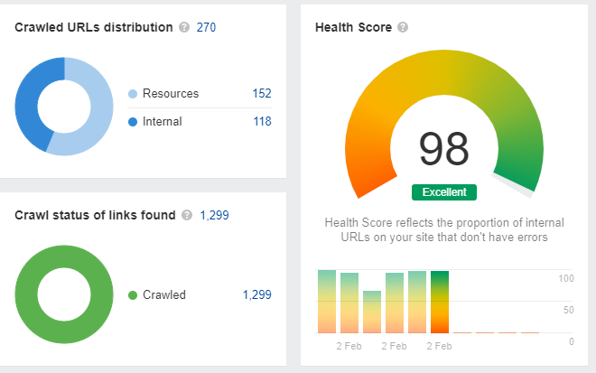
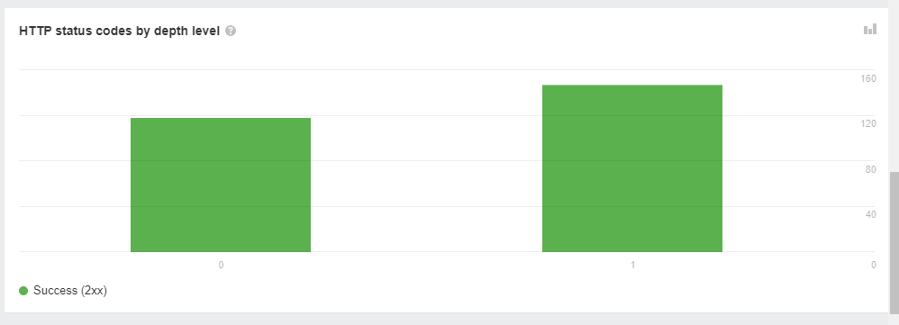
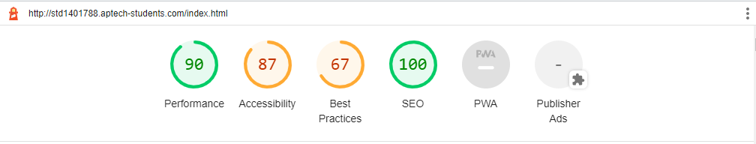
GOOGLE LIGHTHOUSE & AHREFS REPORT

Slide 13

THANKS FOR WATCHING
TILL THEN KEEP LEARNING AND KEEP EXPLORING

